Slide 1
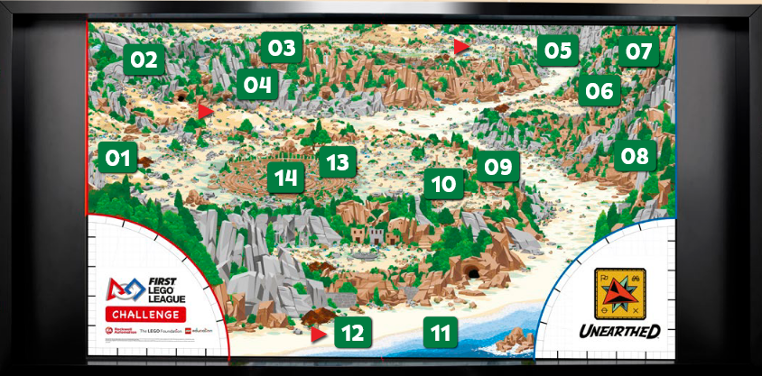
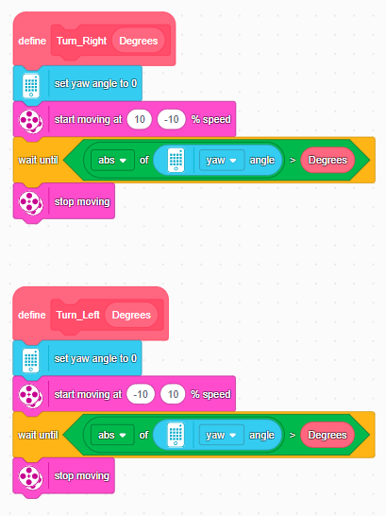
Our Mission Robot
Our Mission Robot

Slide 2
Our Mission Robot
Robot pic with arrows to key parts: chassis, left arm, right arm, and front roller/wheels.
One kid explains in 2–3 sentences: what problem it solves (which missions),
why it is tall (to reach high elements), and
why it is narrow (to fit between models).

Slide 3
Twin Arms, Different Jobs
Left arm is being used to solve missions from right home, as the design suits to the missions to be solved.
Right arm has two different attachments for two different mission solutions and left arm uses same attachment to solve multiple missions. It was decided based purely on nature of the missions.
These two arms are of basic design which is easy to repair and contains parts that are easy to replace/rebuild.
One arm is used to grab the model with two prong attachment and also to lift the statue after replacing with a wing attachment.
Second arm is used to lift, drop and pull which needed to have a fork type of attachment.
The reason for its tall arms to reach far away models which saves time, since they are kind of fixed, we make sure the height is within allowed 12 inches.
7. Box body is to have more stability while making turns, lifting and to easily move between missions.

Slide 4
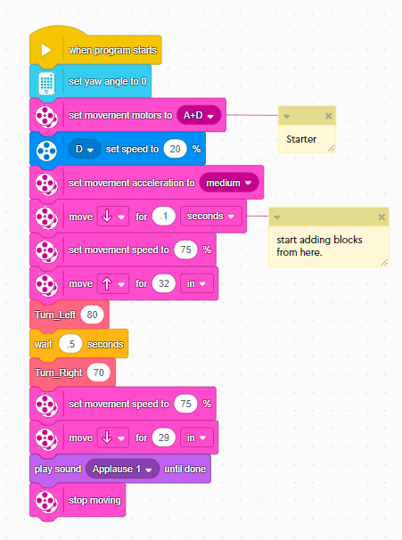
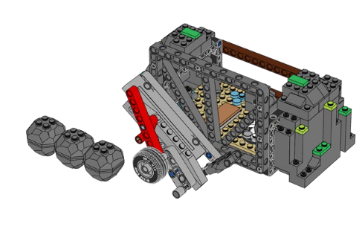
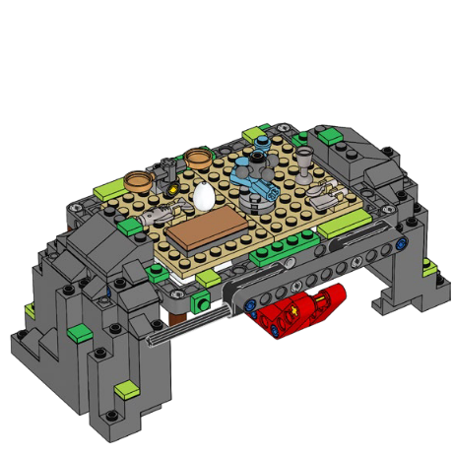
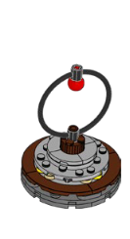
Forge, Heavy lifting & who lived here?

Slide 5
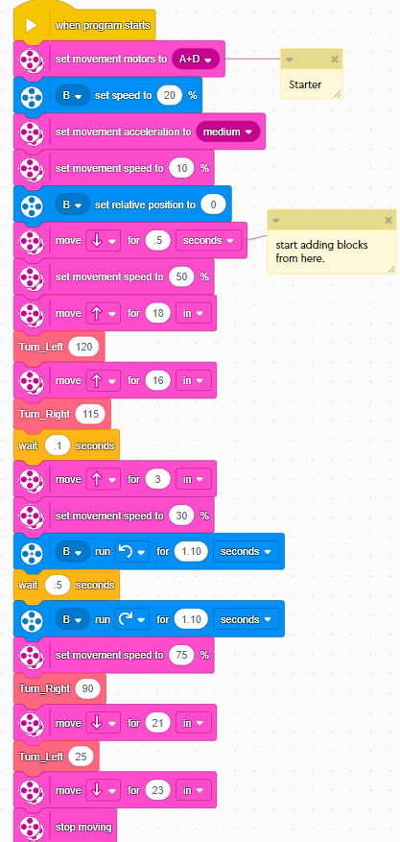
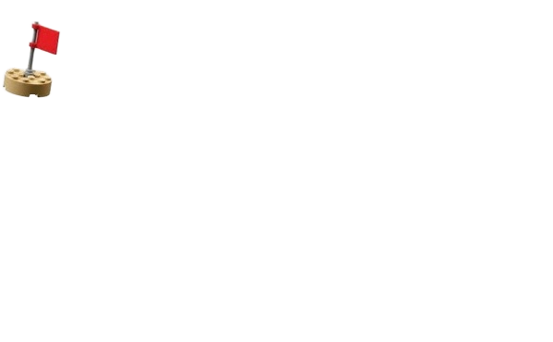
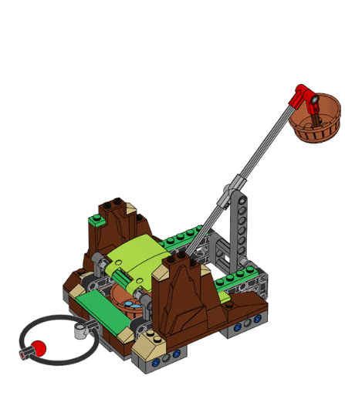
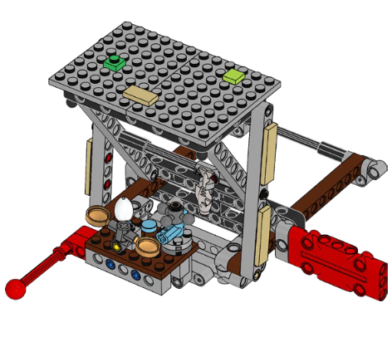
Tip the Scale & what’s on Sale?

Slide 6
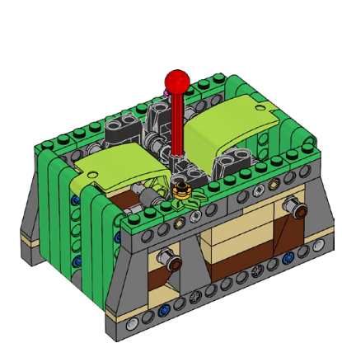
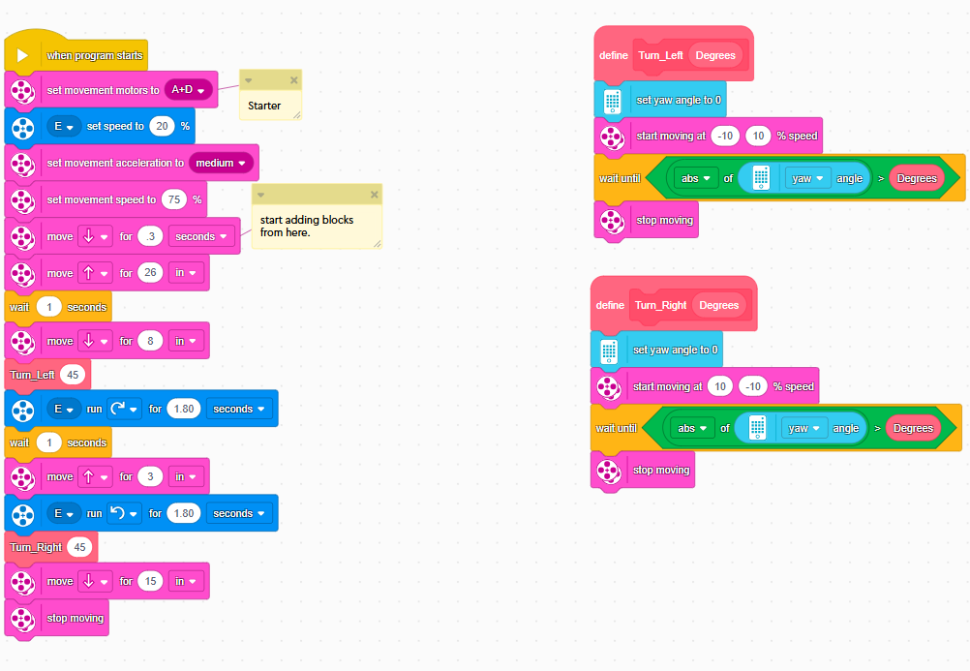
Surface Brushing

Slide 7
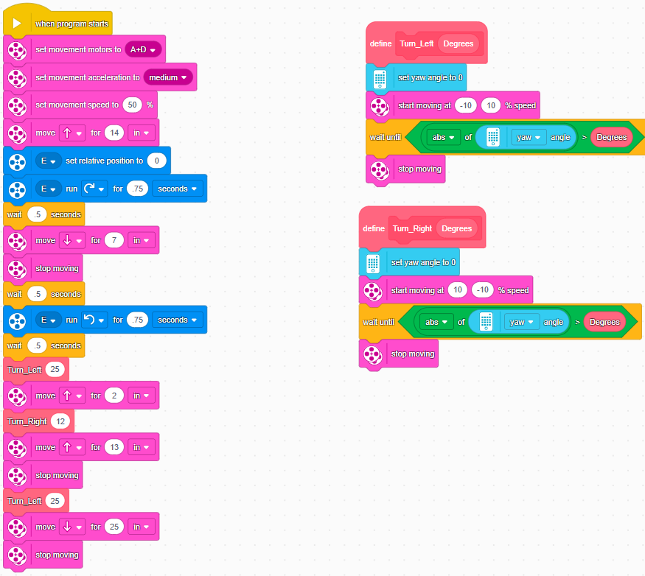
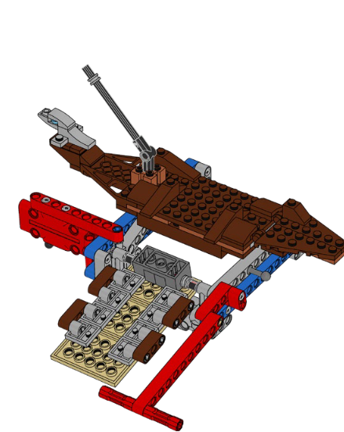
Salvage Operation

Slide 8
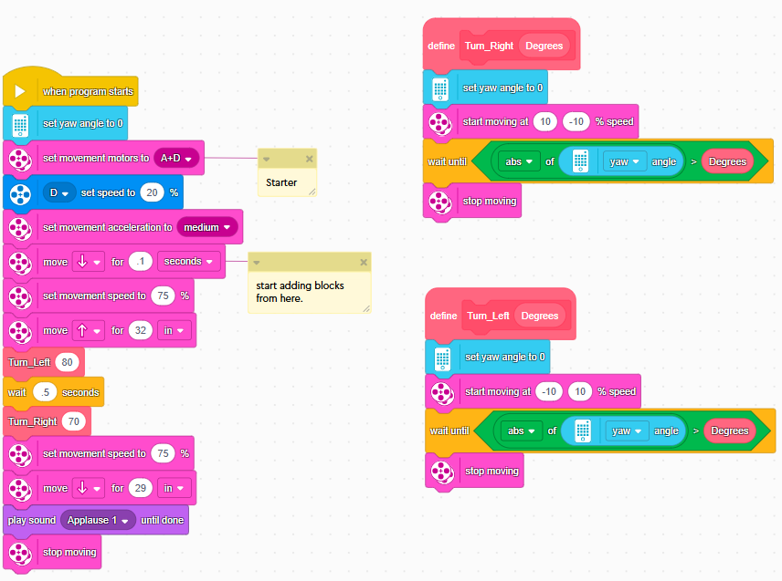
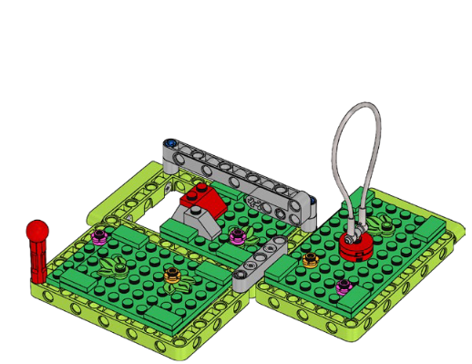
Map Reveal

Slide 9
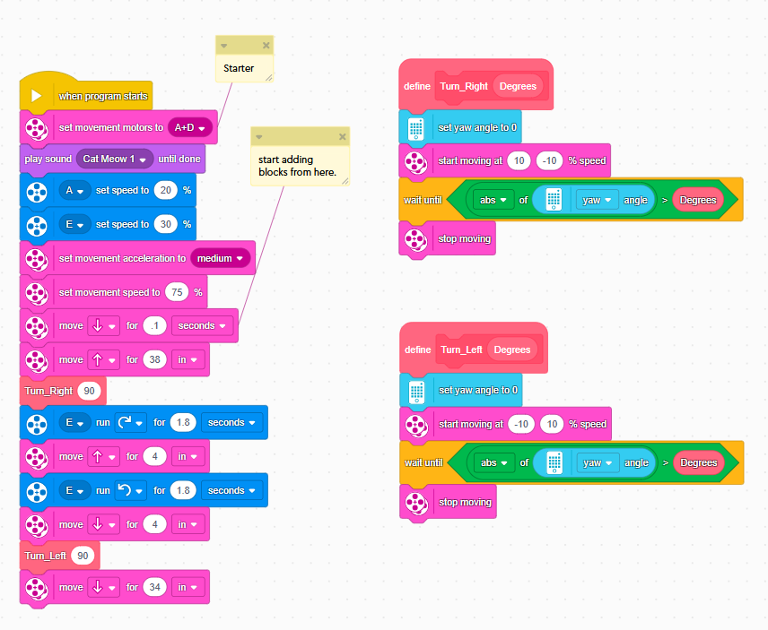
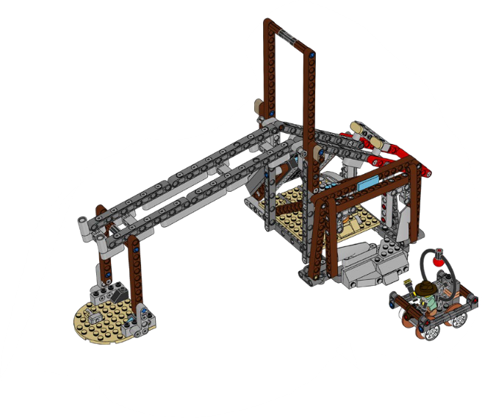
Careful Recovery

Slide 10
